Slide 1
About my website
Shrushti Rathore

Slide 2
Project guide: meghna mam
Name: Shrushti Rathore
Enrollment no.: 2204030102608
Class: M1A4
Subject: Internship OGT

Slide 3
DESCRIPTION OF PROJECT:
I have created a website using HTML,CSS and BOOTSTRAP.
I have used different types of tags in this website. I took help from bootstrap page and styled my website using html and css. I have created four files: index, contact, services, about us.

Slide 4
Tags used:
<nav>: website nav is essential for web design because it allows users to access the information we want as quickly as possible by presenting an enjoyable, intuitive layout while increasing ease of use.
CSS tags: CSS makes the front end of a website shine and it creates a great user experience. Without it, websites would be less pleasing to the eye.
<div>: it is used in html to make divisions of content in web page like text, images, header, footer, etc. it helps us to separate out data in web page and create a particular section for particular data or function in web pages.
Bootstrap: bootstrap flexibility enables designers to create the basics of web design- such as dropdown menus, tables, forms and buttons.

Slide 5
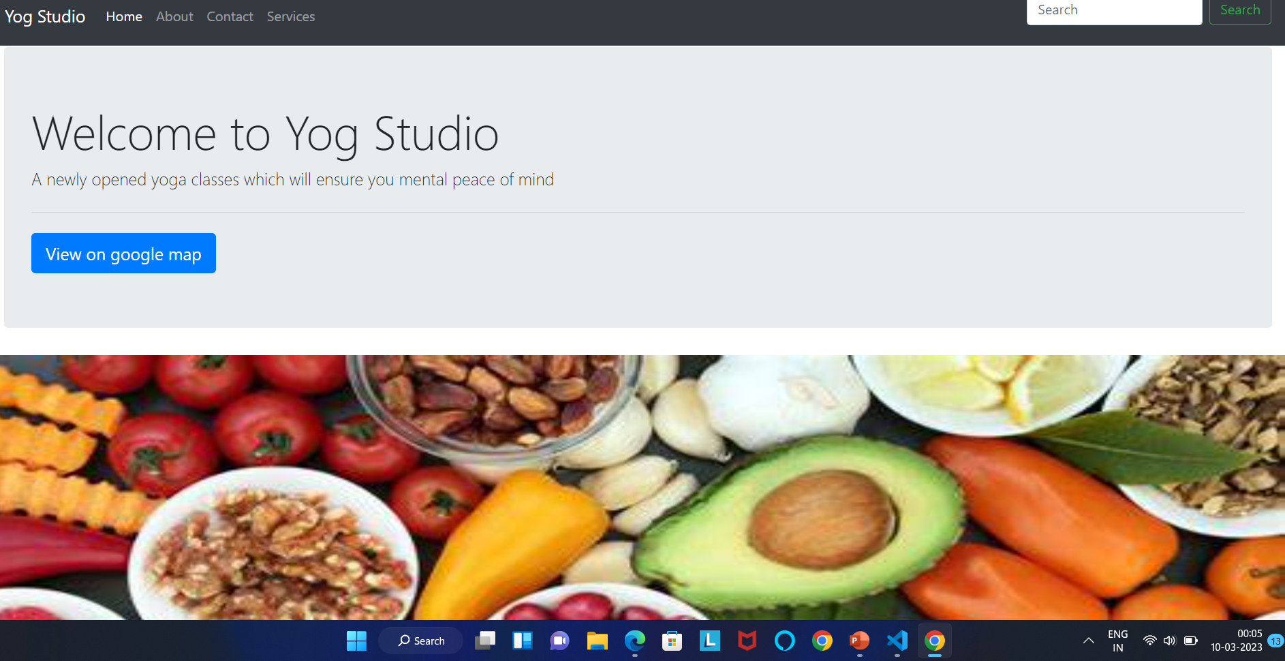
Home page

Slide 6
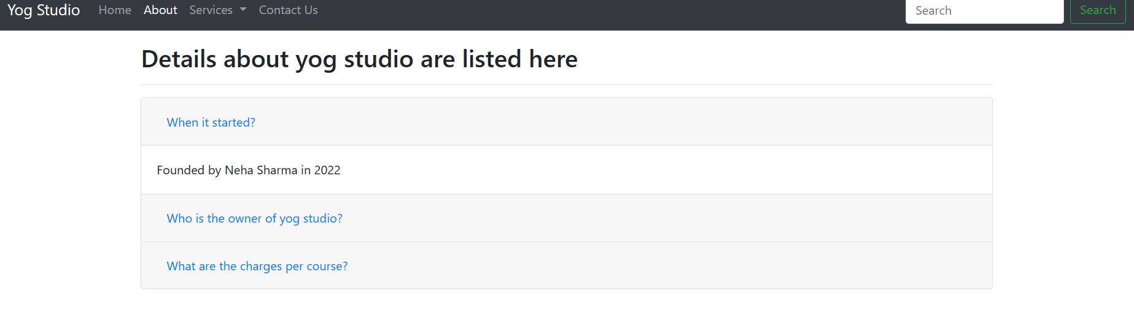
about

Slide 7
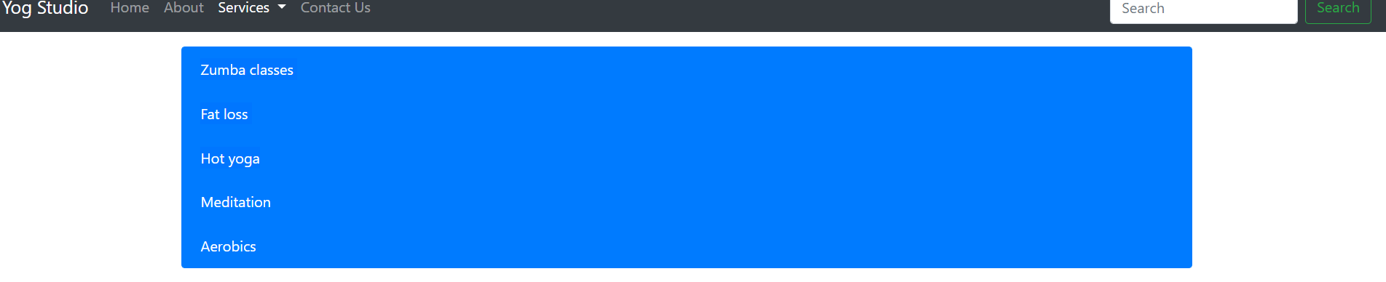
services
Richard Branson

Slide 8
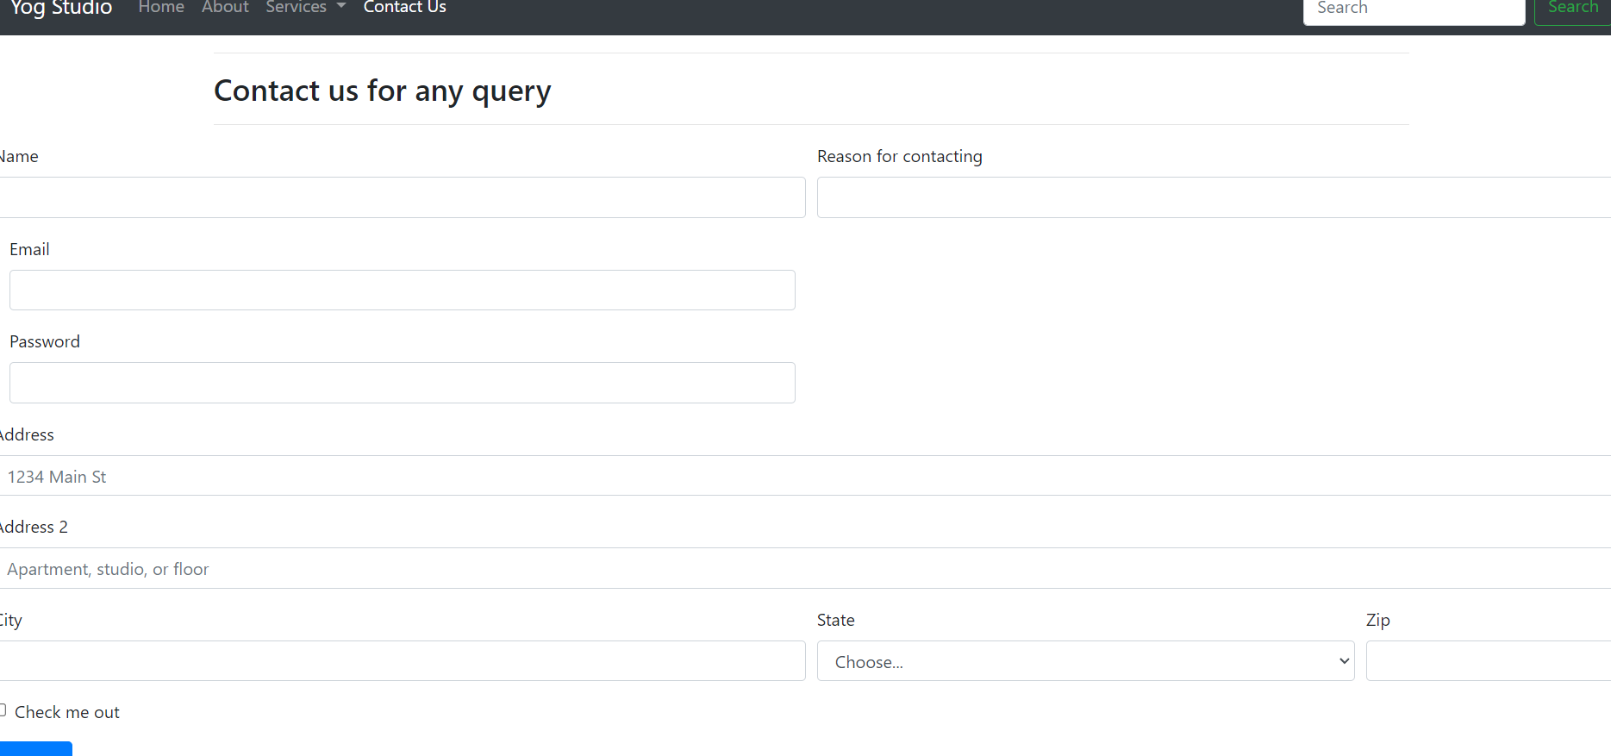
Contact us
TAKUMA HAYASHI
MIRJAM NILSSON
FLORA BERGGREN
RAJESH SANTOSHI
Chief Executive Officer
Chief Operations Officer
VP Marketing

Slide 9
MAJOR THANKS :
ARYA PADHIYAR
MEGHNA MAM
SAGAR RATHORE

